Slide 1
Analyzing Risk
Dr. Risala Tasin Khan
Professor
IIT, JU

Slide 2
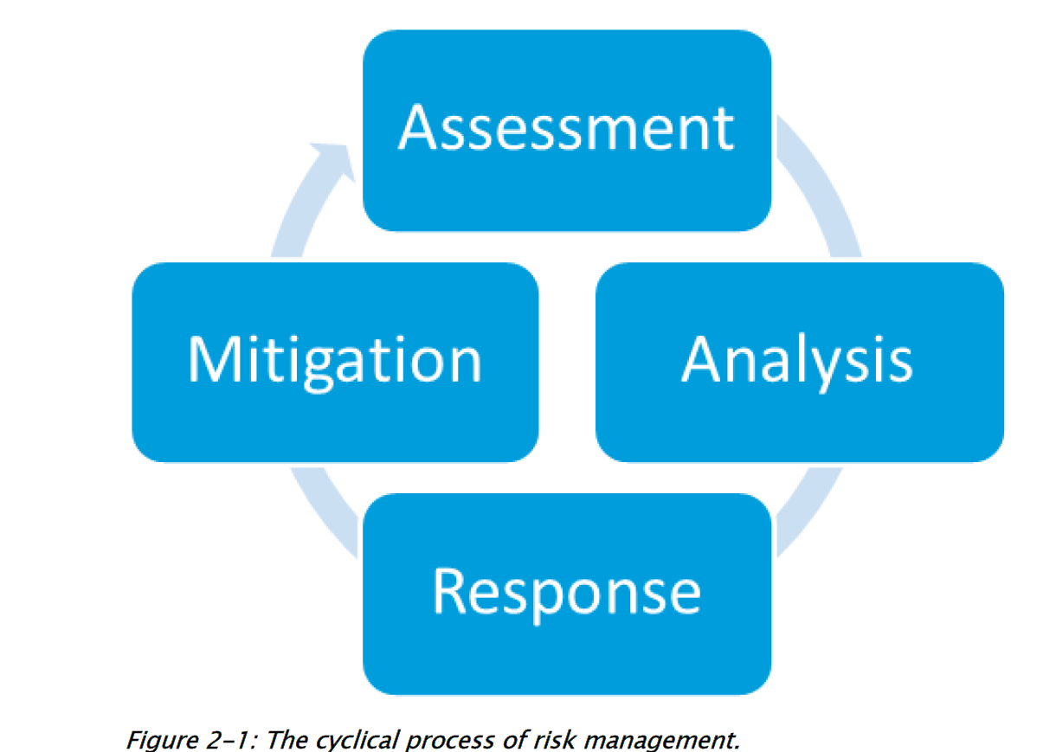
Risk Management
In the information world risk comes in many different forms.
If a risk is not managed properly, it could result in discloser, modification or interruption of a critical asset.
Risk management is a cyclical process that includes four phase:
Identify and assess risks that exist in a system
Analyze the potential impact risks will have on a system
Formulate a strategy on how to respond to risks.
Mitigate the impact of risks for future security.

Slide 3
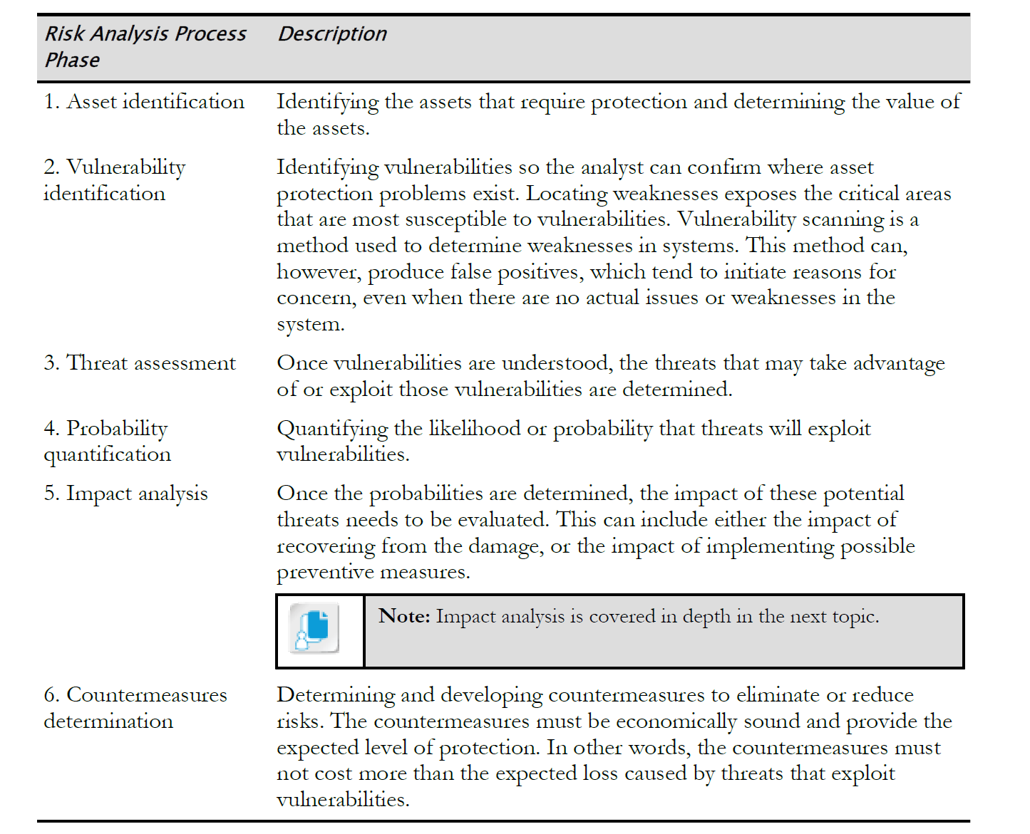
PHASES OF RISK ANALYSIS

Slide 4
Some common used terms
Asset A resource that your organization needs to function
Vulnerability A weakness in the configuration of hardware or software
Threat An event that can cause harm to the asset
Threat vector A tool, or mechanism, the hacker uses to exploit a weakness on a system
Threat actor The person (hacker) using the threat vector to compromise the system
Threat target The system or device being attacked
Risk When the threat to an asset can cause harm to the organization—typically resulting in a financial loss
Risk analysis The identification and planning of mitigation techniques to reduce and manage the risks to your organization

Slide 5

Risk Analysis Process

Slide 6
IDENTIFYING ASSESTS
The first phase of performing a risk analysis, also known as a risk assessment, is to identify the assets within the organization and the value of those assets.
This phase is also known as asset identification.
For example, if a company earns revenue by selling products online, the web server hosting the e-commerce web site would be considered an asset to the company.
During this phase, be sure to focus on identifying the assets instead of worrying about things like the threats to those assets—that will come in the next phase.

Slide 7
Identifying Assets (cont..)
By focusing only on what the assets are, you properly identify all assets of the organization.
The following is a list of common assets held by organizations:
Hardware and software
The organization’s information and data
The building(s)
Inventory and cash
Personnel
The organization’s reputation and branding
Computer systems and services

Slide 8
Risk Assessment Process
IDENTIFYING THREAT OF EACH ASSEST(THREAT ASSESSMENT)
Once you have identified the assets in the organization, you then turn your focus to threat assessment, which involves identifying the threats to each of the assets identified in the first phase.
Continuing with the preceding example, a company e-commerce web site has a number of potential threats; for example, the system could be hacked via a buffer overflow exploit or an SQL injection attack.
The web server could also experience a hard drive failure, which could cause the system to be down for a long time, resulting in lost revenue.
When performing the threat assessment, it is important to identify threats from different sources—or different types of disasters.
There are environmental threats, person-made threats, and both internal and external threats.

Slide 9
THREAT ASSESSMENT(Cont..)
The following identifies these different types of threats, also referred to as risk types:
Environmental An environmental threat results from the environment, or location, in which your business operates.
Environmental threats include, among others, floods, tsunamis, earthquakes, volcanic eruptions, tornados, blizzards, lightning storms, and hurricanes.
Person-made A person-made threat, also known as a manmade threat, is a threat that does not exist naturally but instead is a result of human actions, whether intentional or unintentional. Examples of manmade threats would be viruses, fire, theft, vandalism, and sabotage.
Internal and external It is important to note that threats can be either internal or external. An internal threat comes from someone inside the organization. This could be a threat such as a disgruntled employee intentionally deleting customer data, or an employee accidentally deleting a file. You need to protect from both types of threats. An external threat comes from outside the organization and could be, for example, someone on the Internet trying to hack into your mail server or your web site.

Slide 10
THREAT ASSESSMENT(Cont..)
Legacy systems The threat or risk of having a legacy system connected to the network is that the legacy system may no longer be supported by the vendors of the system’s hardware or software. For example, the vendor may no longer create security patches for the legacy system, making it vulnerable to attacks. If you do require that legacy systems stay in production, look into placing them on their own segment.
Multiparty A multiparty risk or threat is a risk to multiple people or companies.
For example, if you lease a car, you are concerned about the risk to the car as the lease owner, but so are the leasing company and the insurance company.
IP theft Another common threat or risk to organizations is the theft of intellectual property (IP). An example of this threat could be due to an insider within the organization who had access to confidential company data and took it with them when they left the company and went to the competition. You can mitigate the risk of IP theft by implementing encryption and access control policies.
Software compliance/licensing Another major risk to an organization is in regard to software licensing and compliance. It is easy for large organizations to lose track of the number of software licenses they require, so it is important to perform regular audits to ensure that your company is in compliance with licensing requirements. Organizations not in compliance with licensing may face legal repercussions and fines.

Slide 11
Vulnerability Identification
It is important to understand that many threats come from the fact that weaknesses, or vulnerabilities, exist in the assets of the organization.
For example, the vulnerability could be a system that has not been properly protected, which results in the threat of the system being hacked.
The following outlines some common vulnerabilities that may exist:
No system hardening It is very important to understand that a system that has not been properly secured, or hardened, helps create the threat that the system will be hacked.
No physical security Having no physical security in place can result in a number of potential threats, from having the asset stolen to breaching data confidentiality.
No security controls on data Having no security controls on your data means that you have threats relating to confidentiality and to tampering with data.
No administrative controls An administrative control is a policy or procedure. If you don’t have any policy or procedure to follow then you might break law or fail to meet important standards.

Slide 12
Vulnerability Identification(Cont…)
Various types of threats could exist for any number of assets that your organization may have.
The following is a list of common examples of threats:
Theft: Theft is a huge threat nowadays because you are dealing not only with physical theft of an asset but also with digital theft of information assets.
System hacked from inside: You could have critical systems or services on the network compromised by an internal employee, whether intentional or not.
System hacked from outside: You could have public servers such as web, FTP, and SMTP compromised by someone external to your network (Internet).
Natural disasters: Natural disasters such as flooding, hurricanes, and tornadoes are examples of threats against the business continuing its operations.
Hardware failures: When running servers that hold critical data or functions, it is important to identify hardware failures that could occur. The hardware could be hard drives, network cards, or even machinery in a production plant.
Fraud: This is a bit trickier to identify, but watch for threats of fraud because employees could be tampering with information or company processes to gain a financial benefit.

Slide 13
ANALYZE IMPACT
The goal of impact analysis is to identify what the result of the threat occurring would be on the business. For example, if the company’s e-commerce web site has a denial of service (DoS) attack performed against it, then the impact is that the server could be down for days, resulting in lost revenue.
A tangible impact involves a visible loss to the company; for example, the company loses money due to no revenue being generated.
The following list outlines common tangible impacts:
Loss of revenue or business opportunity The common impact is that the company loses the opportunity to generate revenue when the threat occurs because the asset has been compromised and is unavailable.
Loss of money due to cost to fix Another extremely visible impact is the loss of money due to the cost of fixing the asset after the threat occurs. This typically is in addition to the loss of revenue.
Loss of production Loss of production is a common impact of a threat occurring to equipment or inventory.
Employee safety Some threats may not result in loss of revenue directly, but result in a safety issue for employees.

Slide 14
ANALYZE IMPACT
The impact of all threats is not always so visible, and sometimes the effect of the threat occurring is not seen for some time after the threat occurs. These types of impacts are known as intangible impacts.
The following list outlines some common intangible impacts:
Company reputation One of the more common intangible impacts is that when a threat occurs, it could ruin the company’s reputation, which is never good for business!
Failure to follow regulations A threat occurring may have the impact of your company being unable to follow regulations or standards. This could result in legal action against the company or sometimes even loss of insurance.
Loss of customers’ confidence If the company e-commerce web site is hacked and this information goes public, you may lose the confidence of your customers (or shareholders), and they may no longer wish to purchase online items due to fear of credit card numbers being captured by hackers.

Slide 15
PRIORITIZE THREATS
Once you have identified all of the threats that could occur against each asset, you must prioritize the threats based on their impact and probability of occurring (also known as likelihood of occurrence) so that you can deal with the more serious threats first.
How you prioritize the threats will depend on the type of risk analysis being performed; for example, if you are doing a qualitative analysis, you will assign values based on some form of scale to each threat (such as low, medium, and high), and then focus on the high-level threats first. More on the types of analysis in a little bit.
Therefore we need to create a risk register.
A risk register is a tool that is used to plot a description of the different threats, along with their impact and probability

Slide 16
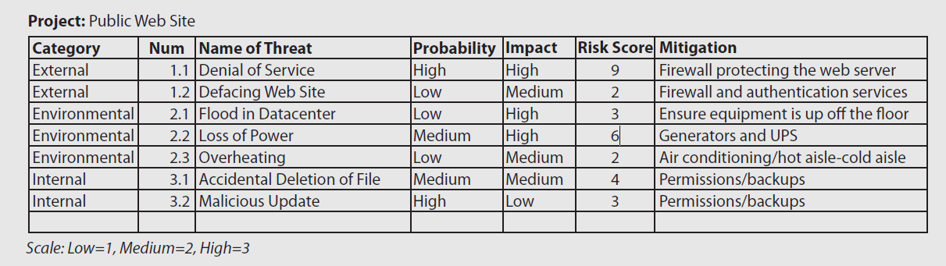

Slide 17
Supply Chain Assessment
Supply chain assessment involves identifying any risks within the supply chain and mitigating those risks.
For example, the assessment might evaluate what to do if there is a shortage of raw materials or if there is a fire at the manufacturing plant.
All such threats could present risk to your business.

Slide 18
Testing
When assessing threats against your organization’s assets, it is important to perform different types of tests.
You could perform a vulnerability test, also known as a vulnerability scan, to test whether your systems are vulnerable to different exploits and weaknesses.
You could also perform a more active type of test known as penetration testing, where the tester tries to bypass security controls and gain access to a system.
There are a number of other forms of tests that can be performed that do not relate directly to technology.
For example, your organization should perform fire drills on a regular basis.
You could also test your business processes by testing supplier delivery flexibility and stock levels by testing rush orders.

Slide 19
Change Management
After testing your systems with either a vulnerability scan or a penetration test, you may discover that you need to make changes to the configuration of the systems in order to make them more secure.
When making changes to the system configuration, be sure to follow the change management process that your organization has set out.
This process typically involves applying the change to test systems first, backing up the production system before making the change, applying the change, and then verifying the proper operation of the system after the change.
The key to change management is the documentation.
For example, when planning for changes, you should document the desired changes, document what to do if the changes do not go as planned (this is called the rollback plan), and then summarize the results of the change operation.

Slide 20
Identify Mitigation Technique
Once you have identified the threats and prioritized them, you know which threat solutions to focus on, or at least how to reduce the risk of the threat occurring.
This is known as mitigating the threat.
Mitigating the threat typically involves spending money on a solution that implements a security control to protect the asset from the risk.
You can implement fault-tolerant technologies, firewalls, encryption, or access control systems, to name a few.

Slide 21
Evaluate Residual Threats
Once you have implemented solutions to mitigate the threats, reevaluate the asset and identify any threats that may still exist.
The remaining threats are known as residual risk.
It is critical to express this residual risk to management so that they can decide if they are willing to accept that residual risk or want to implement additional security solutions.

Slide 22

Tools to Help Analyze Risk

Slide 23
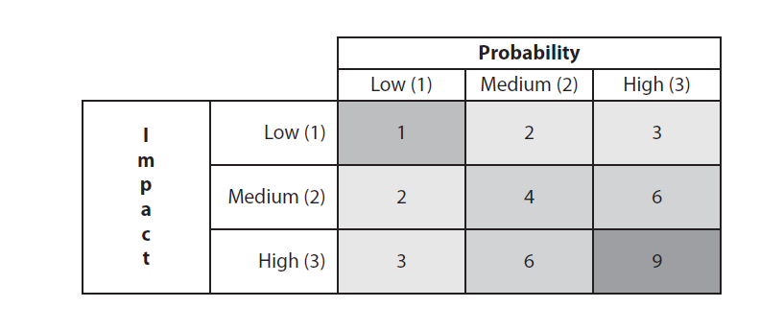
Risk Matrix/Heat Map
A risk matrix, also known as a heat map, is a tool used to assign a risk value on a particular event to help decide what the risk level is.
Looking at Figure , you can see that the risk matrix has a listing on the left for the impact level of an event, and then across the top are the probability levels of the event happening.
Let’s say that an event such as a DoS attack against your e-commerce site has an impact of high (3) but a probability of medium(2). That would give you a risk value of 6 (3 × 2).
Also note that each of the risk values are typically colored so that visually you can determine how risky the event is.
A risk value of 1 would be green (meaning minimal risk), yellow squares are used to identify risk levels of 2 and 3, risk levels of 4 and 6 might be orange, and then a risk level of 9 uses a red square to visually indicate high risk.
These colors and values can be modified to fit your organization’s methodology to handling risk.

Slide 24
Risk Control Assessment and Risk Control Self-Assessment
Risk control assessment is the term used when an assessment is performed by a third party that understands the business risk objectives and performs a review of the effectiveness of the security controls to minimize risk.
Risk control self-assessment (RCSA) is the term used to describe the process of internal staff identifying risk and evaluating the effectiveness of the controls that are protecting the asset from risk.
The goal of the RCSA is to ensure the reliability of the controls in place, to ensure the safety of the assets, and to ensure compliance with laws, regulations, and the security policy.

Slide 25
Terms related to Risk
Risk awareness Involves raising awareness of the risks to your assets and understanding the impact of the risks, how to mitigate those risks, and how to manage any residual risks.
Inherent risk Refers to the natural risks associated with a specific activity or business process before a mitigation technique is applied to reduce the risk.
Residual risk The amount of risk that remains after a mitigation technique has been applied to reduce the risk.
Control risk Also known as risk control, this is the process of identifying threats against the assets and identifying controls that can be put in place to protect them.
Risk appetite The level of risk the company is willing to accept based on its goals and objectives. The risk appetite will help determine if a control is needed to protect an asset.

Slide 26
Risk with Cloud Computing and Third Parties
One of the big concerns with cloud services is privacy.
Where is the cloud provider storing the data?
How is it securing the data?
These are questions you should ask and find answers to.
The bottom line is that you are trusting your information to a third party organization. Over the years, many customers are not considering using cloud services due to privacy concerns and regulations that govern their organizations, but cloud providers are more concerned about security issues.
Deciding to use cloud services is something you want to carefully plan.
Also consider hybrid solutions where, for example, sensitive data is stored at your company site (known as on-premises), while nonsensitive data is stored in the cloud to leverage backup services or even high availability of that data.
Note that there are different types of cloud models, such as a public cloud, where your data is hosted out on the Internet, and a private cloud, meaning that you host the data internally within your company.
It is important to note that there are more risks associated with public clouds, as they are not hosted within your organization

Slide 27
Risk with Cloud Computing and Third Parties(Cont..)
The following are some points you should take into consideration when integrating systems and data with cloud services and third-party companies:
On-boarding/off-boarding business partners: In cloud computing, onboarding and offboarding business partners refer to the processes of integrating and removing external entities—such as vendors, suppliers, or collaborators—within a cloud-based ecosystem.
On-boarding involves setting up access, permissions, and resources for new partners to collaborate within a cloud environment. It typically includes:
Identity & Access Management (IAM): Granting appropriate permissions while ensuring security.
Integration with Cloud Services: Connecting their systems to shared cloud resources.
Compliance & Security Checks: Ensuring adherence to data protection policies.
Off-boarding business partner: When a partnership ends, offboarding ensures secure removal of access and data. This includes:
Revoking Access: Disabling credentials and permissions.
Data Migration or Deletion: Ensuring sensitive information is handled properly.
Audit & Compliance Review: Confirming that security protocols were followed.

Slide 28
Social media networks and/or applications: With the growth of social media networks today, organizations need to implement policies and educate employees on what information is allowed to be posted on social media networks and what information is not allowed to be posted.

Slide 29
Risk with Cloud Computing and Third Parties(Cont..)
Interoperability agreements: Ensure you have defined operation agreements with the cloud provider or third-party company. Agreements such as service level agreements (SLAs) specify guaranteed uptime. Check to see if a blanket purchase agreement (BPA) is needed, which is used to cover repetitive needs for a product or service. Ensure that a memorandum of understanding (MOU), sometimes referred to as a memorandum of agreement (MOA), exists. This is a document that establishes an agreement between the two parties and specifies their relationship to one another. Also ensure that you are familiar with your Internet service agreement (ISA) and that you are comfortable with any data limits and the guaranteed uptime of the Internet connection. This is critical if you are taking advantage of cloud services, as you need Internet connectivity to access any services or data in the cloud.
Privacy considerations: As mentioned earlier, you want to be aware that there are risks to storing information with a third party or in the cloud. You are trusting that the service provider is securing that information.
Unauthorized data sharing: When working with third-party organizations, you always run the risk that employees of the third party will share the information with others without authorization.

Slide 30
Risk with Cloud Computing and Third Parties(Cont..)
Risk awareness: Understanding the risks of integrating with cloud services and third parties is important. You have the risk that your data is stored in an unsecure location and that the data being transmitted across the network can be viewed by others if it isn’t encrypted. You should ensure the provider is guaranteeing access to that information. There are other risks to be aware of as well—you may lose Internet access and not be able to access the data in the cloud. You also may encounter a situation where the cloud provider goes out of business—how will you access your data then? Or what if the cloud provider’s hardware is subpoenaed for legal reasons? All of these situations could cause you to not be able to access your data in the cloud.
Data ownership :Ensure the interoperability agreements specify who owns the data being stored in the cloud or with the third-party company. Some third-party companies may believe that if you store the data with them, then the data is theirs. Read all agreements and ensure data ownership is explicitly specified.

Slide 31
Risk with Cloud Computing and Third Parties(Cont…)
Data backups: Data backups are a great use of storage space in the cloud as long as you understand that, in theory, once you store your data in the cloud, you have no idea who is accessing it. If this is a concern and you really want to store your data in the cloud (especially if it is not sensitive information), then encrypt the information before backing it up to the cloud.
Follow security policies and procedures Ensure you follow your organization’s security policies and procedures when working with cloud services and third-party companies. If you are the security officer responsible for updating the policies, then ensure you update them to include the organization’s rules regarding cloud services.
Reviewing agreement requirements to verify compliance and performance Standards: This item is really important. You must read all agreements to make sure you are maintaining compliance with any regulations that govern your organization.
For example, due to privacy concerns, many government agencies and medical departments cannot store information in the cloud or at a third-party company.

Slide 32

RISK ASSESSMENT TYPES

Slide 33
Qualitative Assessment
As mentioned, qualitative risk analysis determines the risk and mitigation techniques without actually calculating the loss as a dollar figure.
With qualitative risk analysis, you create a scale of values to rate each threat based on the numbers in the scale.
Before we look at examples of the scale, you first need to understand the formula to calculate risk, even with qualitative risk analysis. The formula is that risk is equal to the probability multiplied by the loss (also known as the impact):
Risk = Probability × Loss
With qualitative risk analysis, instead of spending time figuring out the actual dollars and cents, you focus on assigning a value based on the scale you create.
This saves time during the analysis because you are not actually trying to figure out an exact dollar figure.

Slide 34
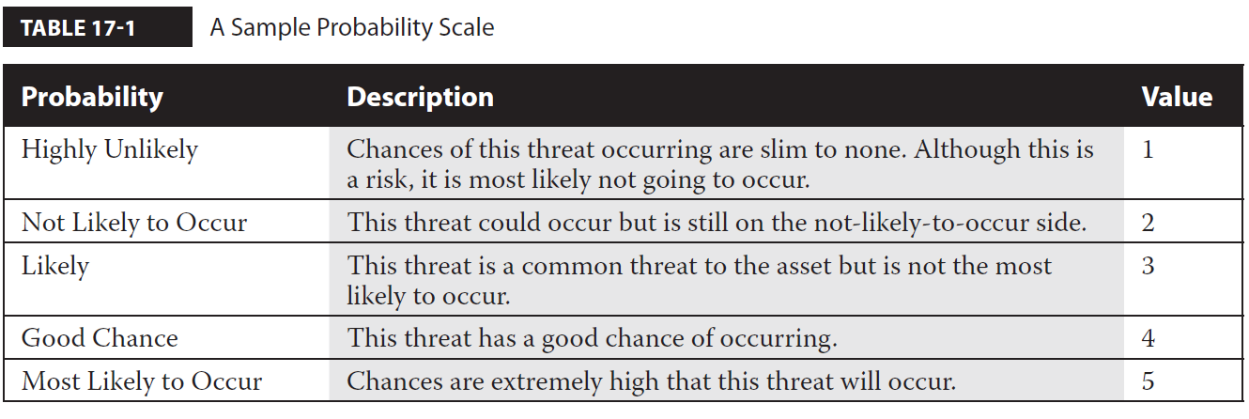
Qualitative Assessment(Cont..)
The first step is to create a scale for the probability of a threat occurring.
Table 17-1 displays an example of a table of probability values.
Other terms for probability are likelihood and likelihood of occurrence, which is the term used by the Security+ certification objectives.
The table reflects that you have decided on five values for probability.
With each of the threats listed with the assets, you will assign a probability value to indicate how likely it is that the threat will occur.
For example, the web server hosting a public e-mail site has a threat of a denial of service attack, and you assign the threat a probability of “Likely,” which has a value of 3.

Slide 35
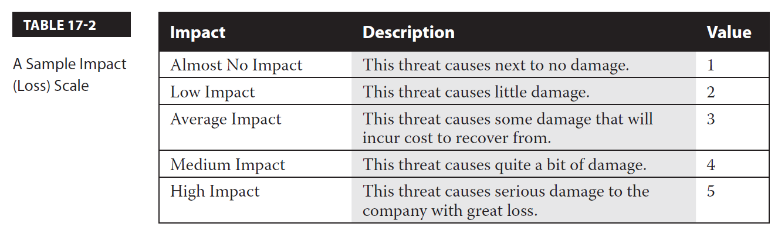
Qualitative Assessment(Cont…)
Once you have determined the probability, you will identify the impact associated with each of the threats.
Like the probability, the loss is based on a scale—you may want to use a “low/medium/high” scale, or come up with your own scale, such as the one found in Table 17-2.
Looking at the table, you can see I have gone with another scale that has five values.
This gives you some flexibility when assigning an impact to each of the different threats.
For example, you may decide that denial of service attacks to your e-commerce web site have a “Medium Impact” level because they will crash the server and make it unavailable for business.

Slide 36
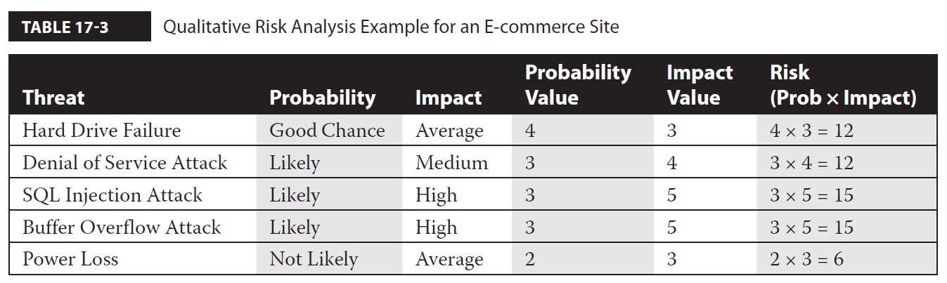
Qualitative Assessment(Cont…)
Once you have identified the probability and the impact (loss) for each of the risks, calculate the risk of each threat based on our formula of risk = probability × loss.
Table 17-3 displays an example of how you should plot the threats against an asset and then calculate the risk associated with each threat by using qualitative analysis.
You measure the risk associated with each of the threats by using the probability and the loss (known as impact).
This allows you to prioritize the threats and to deal with the highest-priority threats first by investing in security solutions to protect the asset from those high-priority threats.
In this example, your high-risk threats are the SQL injection attack and the buffer overflow attack, so you would invest in controls to prevent those threats from occurring.

Slide 37
Quantitative Assessment
With quantitative analysis, you calculate dollar amounts for each of the risks and what the impact of the threat is.
This is a critical type of assessment because upper-level management wants to see dollar figures to justify the cost of purchasing a security control to protect the asset.
For example, with quantitative analysis, if you say, “The threat is going to cost us $1,400 a year, so we should purchase a firewall solution that will cost us $6,500 a year over three years,” management may well tell you to find a cheaper solution.
The first step to quantitative analysis is to assess the value of the asset.
For example, you may determine that your e-commerce web site brings in thousands of dollars a day of revenue—this will help you calculate the value of the asset.
Once you know the value of the asset, you then must determine the impact that each threat to the asset would have.
With quantitative analysis, the impact is specified as an exposure factor (EF), which is the percentage of the asset’s value that is lost if the threat occurs.

Slide 38
Quantitative Assessment(Cont..)
Once you know the value of the asset and have an exposure factor associated with each threat, you can then calculate what is called the single loss expectancy (SLE), which is a dollar figure representing how much money the company will lose each time the threat occurs.
The following is the formula for single loss expectancy:
SLE = value ($) × EF (%)
For example, let’s say you decide the e-commerce web site has a value of $200,000, and each time the web server has a hard drive failure, you lose 8 percent of the asset value. This means that your single loss expectancy is $200,000 × .08, which is $16,000.
Therefore, every time the hard drive fails in the server, your business loses $16,000!

Slide 39
Quantitative Assessment(Cont…)
Once you have calculated the single loss expectancy, you can work on calculating the annualized loss expectancy (ALE), which is a calculation of how much money you will lose per year with each of the threats.
The formula to calculate the annual loss expectancy is to take the single loss expectancy and multiply it by the annualized rate of occurrence (ARO).
The annual rate of occurrence is how many times a year you expect the threat to occur.
ALE = SLE × ARO
For example, you may expect a threat to occur three times a year or to occur once every five years. The following example calculates the ALE for our hard drive failure threat if it were to occur three times a year:
ALE = $16,000 × 3
This means that the ALE based on the hard drive failing three times a year would cost the company $48,000. You need to make sure that the solution you implement to protect from hard drive failure does not cost more than $48,000 a year

Slide 40
Quantitative Assessment(Cont…)
The benefit of quantitative analysis is that you are calculating exact dollar figures, which is what management likes because it is easy to see if implementing a solution makes sense financially.
The drawback of quantitative analysis is the time it takes to calculate these numbers; for example, it is difficult to place a value on an asset because so many variables are involved.

Slide 41

RISK MITIGATION STRATEGIES

Slide 42
The following are approaches you can take to dealing with threats:
Mitigate the risk (mitigation) The first way to deal with the risk is by mitigating it. Mitigation involves implementing a security control that protects the asset from the threat. For example, to protect against hard drive failure on the web server, you could purchase a RAID solution.
Accept the risk (acceptance) Another way to handle the risk is to accept it. Accepting the risk means that you do not implement any solution to protect against the threat because you are satisfied that the chances of the threat occurring and the impact of the threat do not warrant the cost of implementing a security control.
Transfer the risk (transference) You can also look at transferring the risk, which means you make the threat somebody else’s problem! For example, you may get insurance that helps you recover from the security incident. It should be noted that for the exam, remember that an example of transferring risk is to obtain cybersecurity insurance.

Slide 43
Avoid the risk (risk avoidance) Risk avoidance is the idea that whatever the activity is that puts you at risk, you decide not to perform that activity any more in order to avoid the risk. For example, you may be concerned that connecting highly sensitive systems to the main network, which is connected to the Internet, runs the risk of the sensitive systems being compromised. In this example, you could have the highly sensitive systems on an isolated network that is air gapped from your main network to avoid network or Internet-based attacks. An air gap means there is no connection between the two networks
Deter the risk (deterrence) A not-so-common approach to dealing with risk is to deter the risk. An example of deterring a risk is to threaten punishment (typically legal punishment) to anyone who attacks the asset—you are deterring the event from occurring.
Enforce technology security controls The most common method to mitigate risk is to implement security controls such as RAID, high-availability solutions, firewalls, encryption, intrusion detection systems, honeypots, patching, and malicious software protection. Another common security control important to businesses is a data loss prevention (DLP) solution—typically software that allows the administrator to define rules for information that is considered confidential or sensitive and does not allow the information to be shared or copied.

Slide 44
Change management Be sure to implement change management procedures in your business and to educate all employees on proper methods to make changes. For example, ensure that developers are making changes to web applications on a development machine and then publishing those changes to a test server to verify they are successful before copying them to the production server.
Incident management A critical part of security is to ensure that you have an incident management team in place and have incident response procedures that the team follows when there is a security incident.
User rights and permissions reviews Take time to assess the configuration of the systems on a regular basis. This includes reviewing the privileges (rights) given on a system and any permissions granted to data. Ensure that the principle of least privilege is being followed because this will help reduce the occurrence of security incidents.

Slide 45
Perform routine audits :A key part of having a secure environment is to perform routine audits. You can perform a number of different audits, from a configuration review to a vulnerability assessment.
Enforce policies and procedures: The security of your organization starts with having a good security policy in place and requiring that the policies and procedures are known. Having strict policies and procedures for employees to follow can help protect against data loss and theft. For example, you should ensure that all employees have a pass code configured on their mobile devices. That way, if a device is lost or stolen, it is harder for someone to get access to the information on the device.

